Slide 1

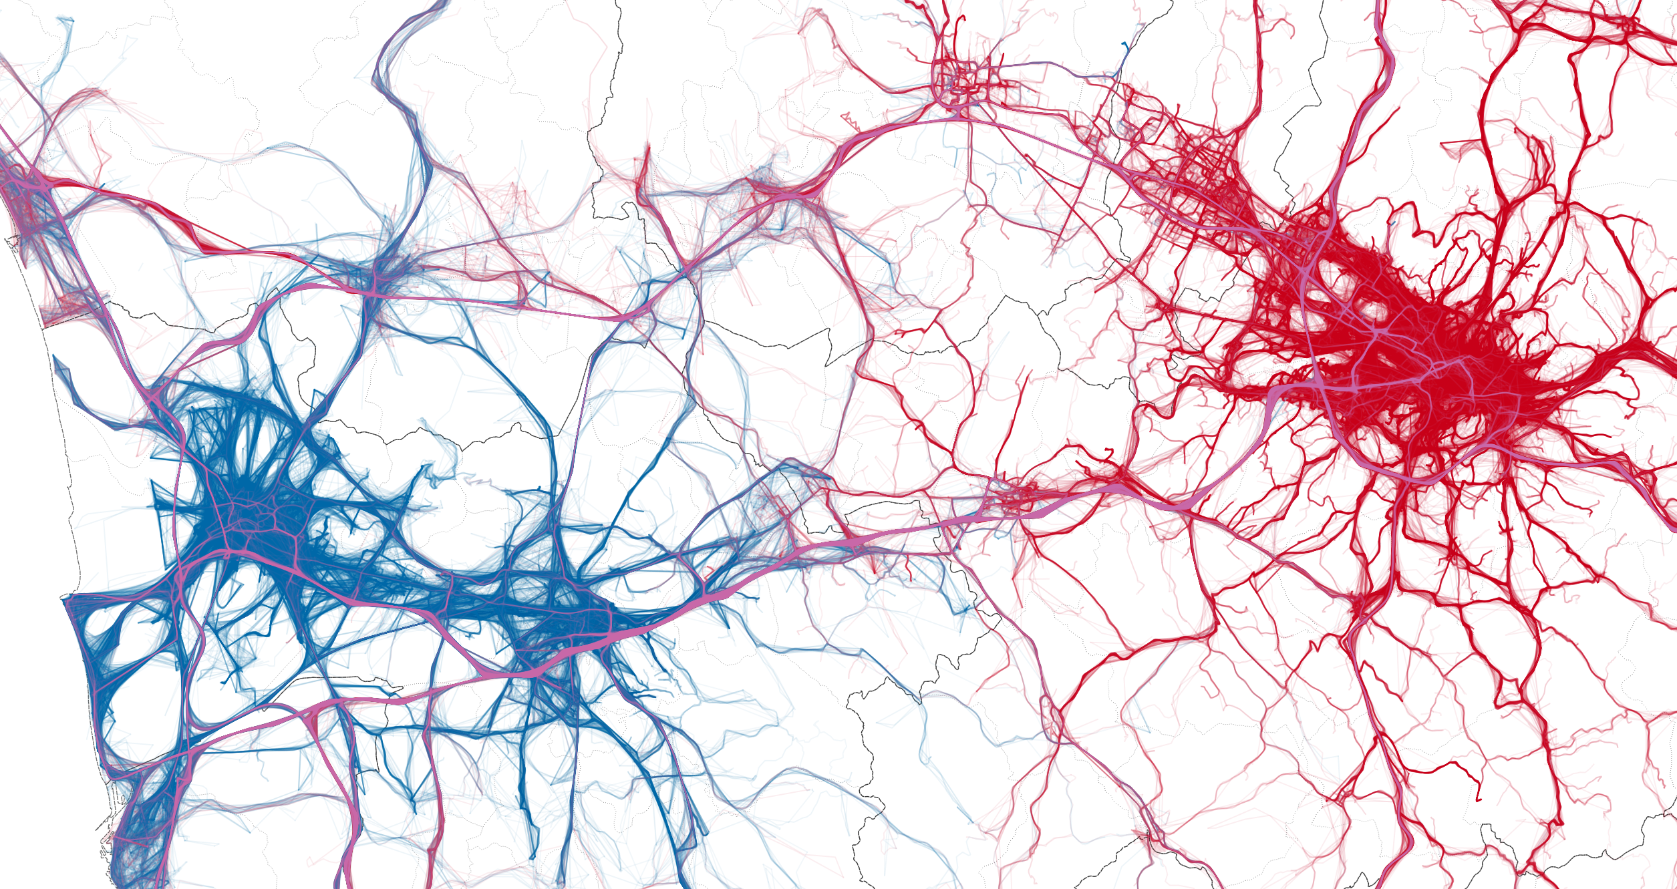

Forecasting Injury for motorcycle accidents
Data Engineering 2 – Term project by the BestTeam Solutions Ltd.
12th December 2020

Slide 2





Presentation overview
Background
A huge navigation company, Baazee wants to develop an audio navigation product for bikers
Our Goal
Convincing Baazee to implement an accident prediction model feature with our help.
As data engineers, we implemented a complete BI architecture demo in KNIME, in which we also leverage a NoSQL solution, MongoDB.
Proposed feature
The architecture supports Machine Learning models to predict bike injuries.
We also built out a visulaisation pipeline for data exploration and potential use of KPIs in the future

Slide 3
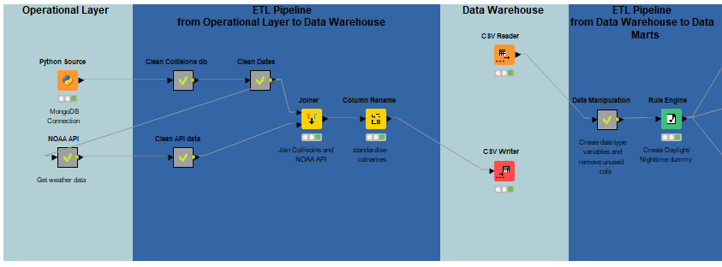


Our KNIME workflow – BI infrastructure w/o Analytics

Slide 4
Data Warehouse
Dimension1: Date&Time
Dimension2: Locations
Dimension3: Weather
Dimension4:
Injury happen?

Slide 5
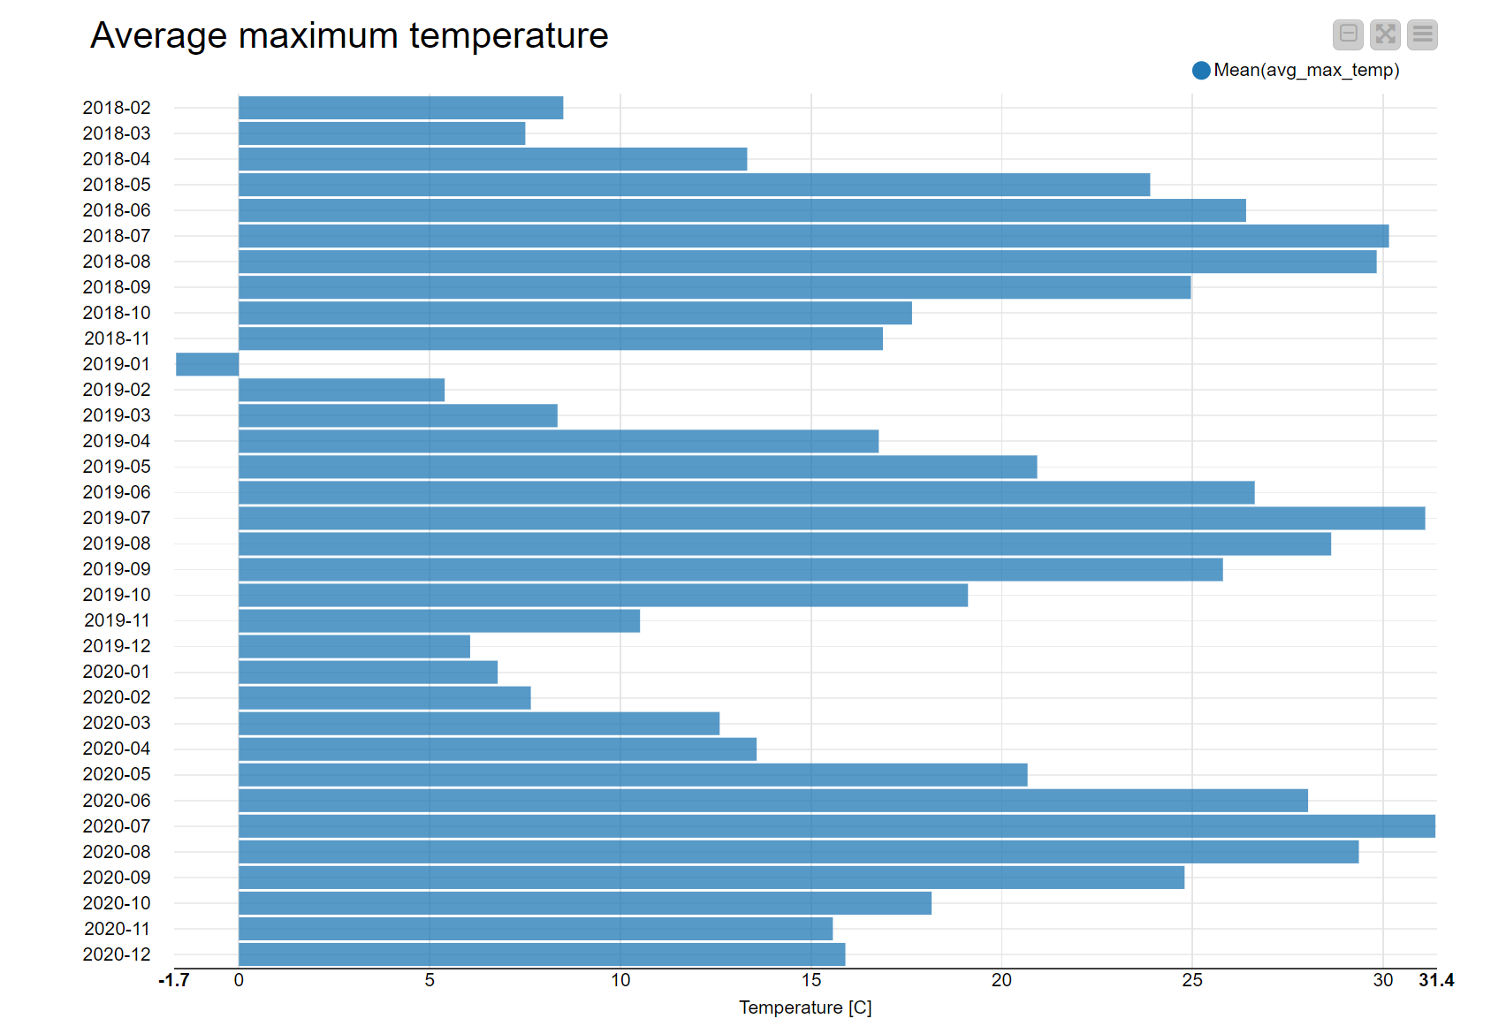
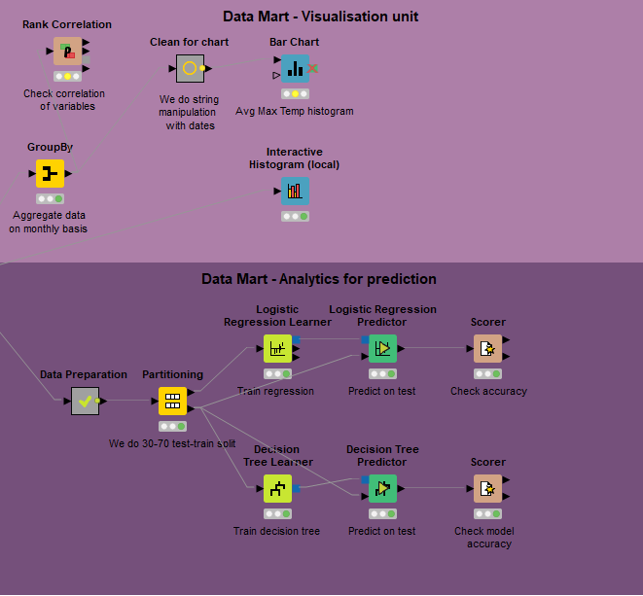
Our KNIME workflow – Analytics

Slide 6
Thank you for your attention!
Questions?

